Slide 1
A Guide to
ANKOS Read & Publish Model
30 January 2023

Slide 2
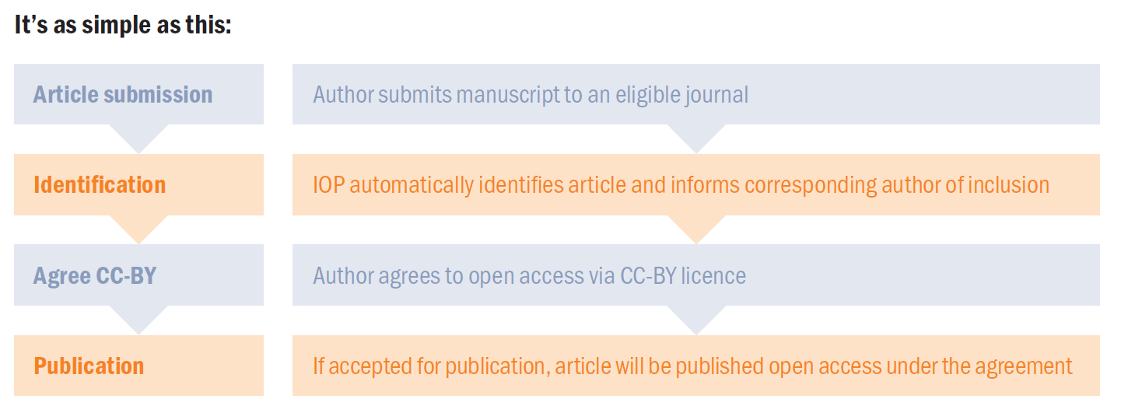
How to publish under the agreement

Slide 3

How to publish under the agreement
  We identify that articles are eligible using the affiliation of the corresponding author
  To be eligible, the article should be accepted within the licence term
  During the peer-review process, or shortly after acceptance we will write to the corresponding author to let them know we will publish the article open access
  Articles are automatically opted in to open access. Although the author can still opt out, this is very rare.
  The corresponding author is the one that submits the manuscript, and is responsible for communicating with the journal during the submission, peer review and publication process.

Slide 4
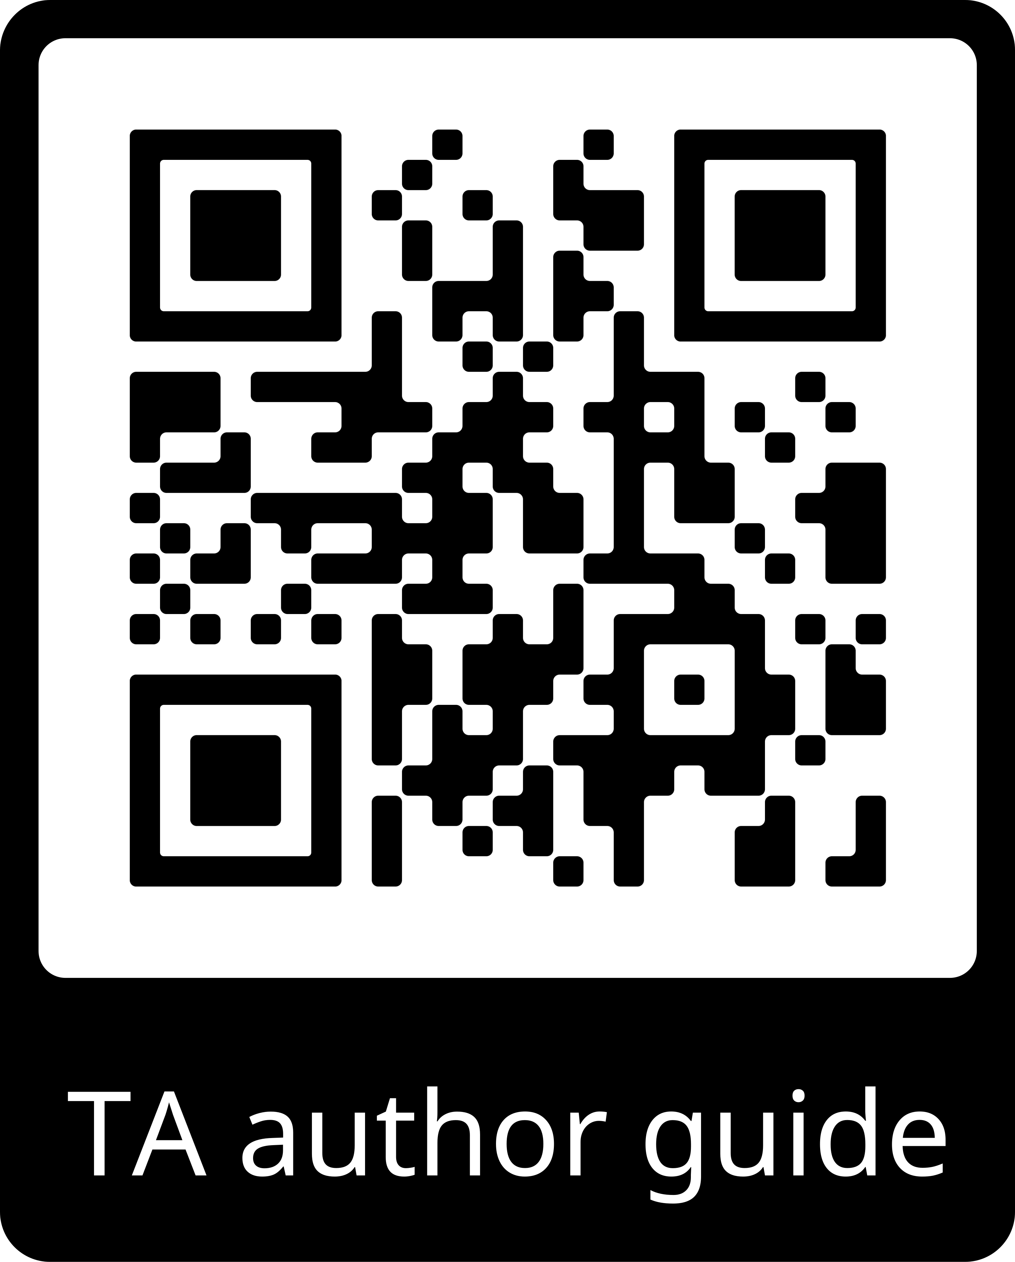
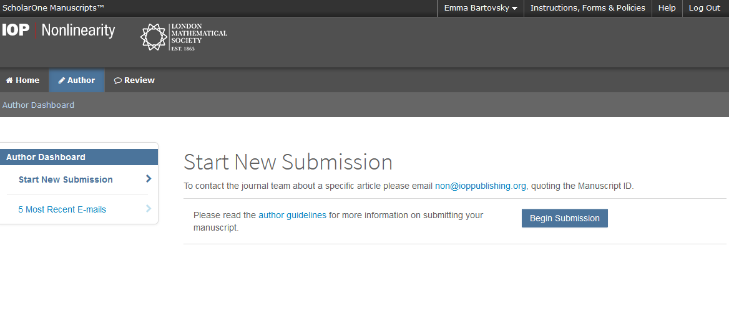
Author Guide
When ready to start the submission, follow steps 1-4 on our submission system; ScholarOne.
The submission process will vary on some of our society partner journals.

Slide 5
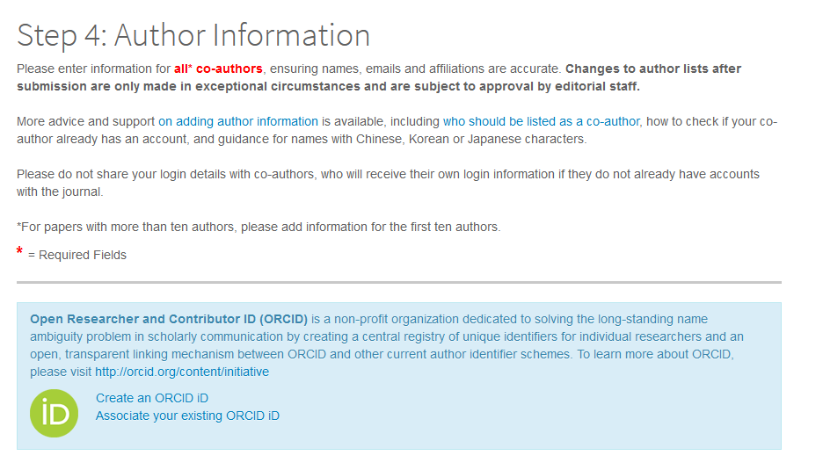
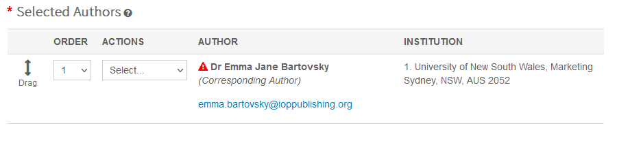
Providing author information
The corresponding (submitting) author will need to make sure their affiliation is clearly stated on the submission form (use the autofill) and on the article itself.

Slide 6
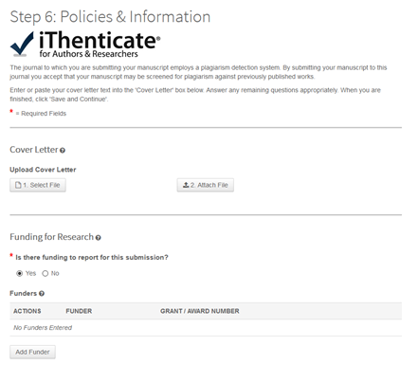
Declaring funding
At step 6 you can declare any funding you received to do your research.

Slide 7
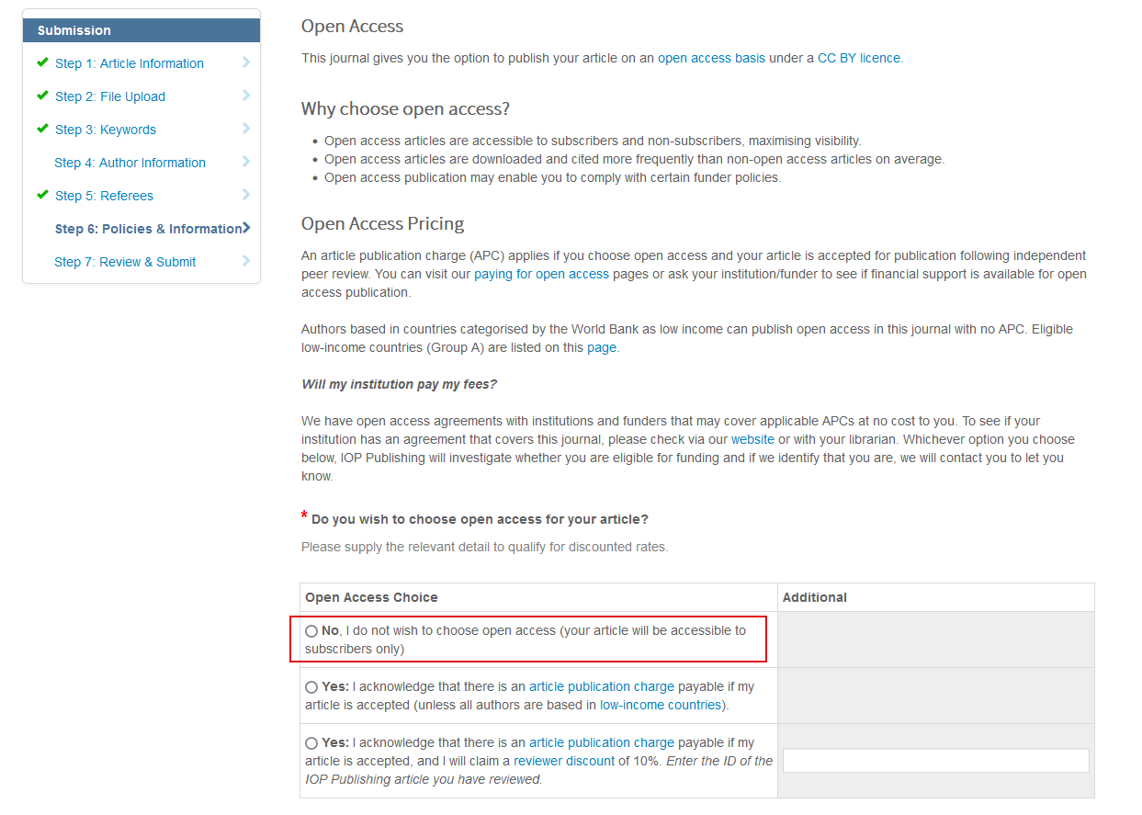
Open access choice
Whichever OA option is chosen, IOP will always identify whether an article is eligible for the TA.

Slide 8
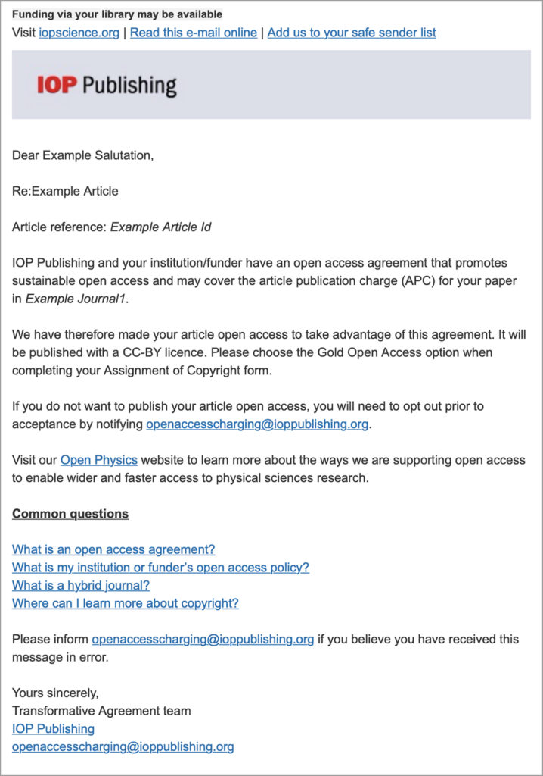
Keeping authors updated
After the first round of peer review, we identify eligible articles.
We’ll email the corresponding author informing them of their inclusion in the agreement.
The subject line will be: ‘Open access options for your article: article ID’
No opt-in action is needed.

Slide 9
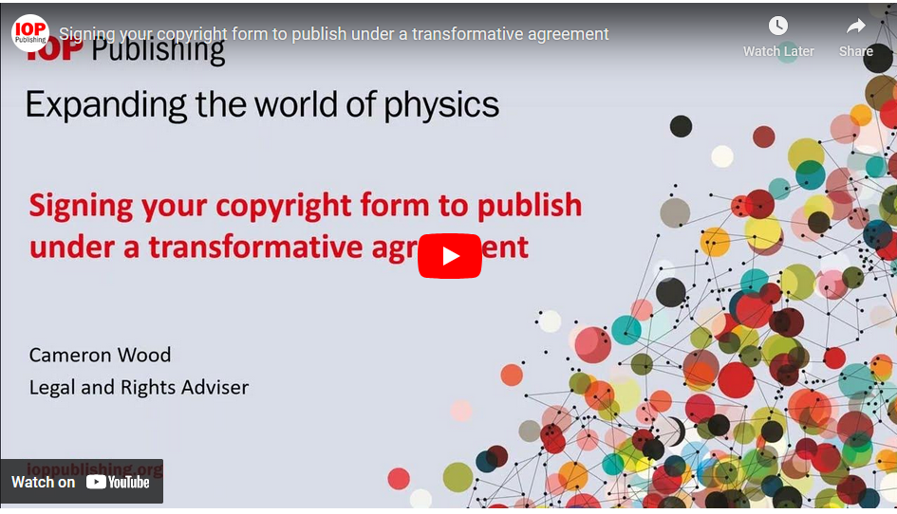
Signing copyright
The author will be asked to sign an open access copyright form and once the article is accepted it will be published open access under the terms of the institutional agreement.

Slide 10

IOPP Journal Finder
https://iopp.chronoshub.io/?fq=
Is there an IOPP journal in materials science that would be covered by a transformative agreement?
Is the journal I want to publish in compliant with my funders requirements?
Is my institution funding APC’s in this journal through a transformative agreement?

Slide 11

Identification
Identification is always based on corresponding (submitting) author
We use historic submission data to inform the identification process
Automatic - authors do not need to do anything
We proactively sweep for missed opportunities
Articles can be made OA retrospectively, as and when they come up – authors have to agree
Wherever possible we make librarians aware of author opt-outs in real time

Slide 12
Reporting
  Quarterly reporting to ANKOS
  Full list of included articles and key metadata
  Author, Title, Journal, DOI, Accept date, Funder (if provided) etc…

Slide 13
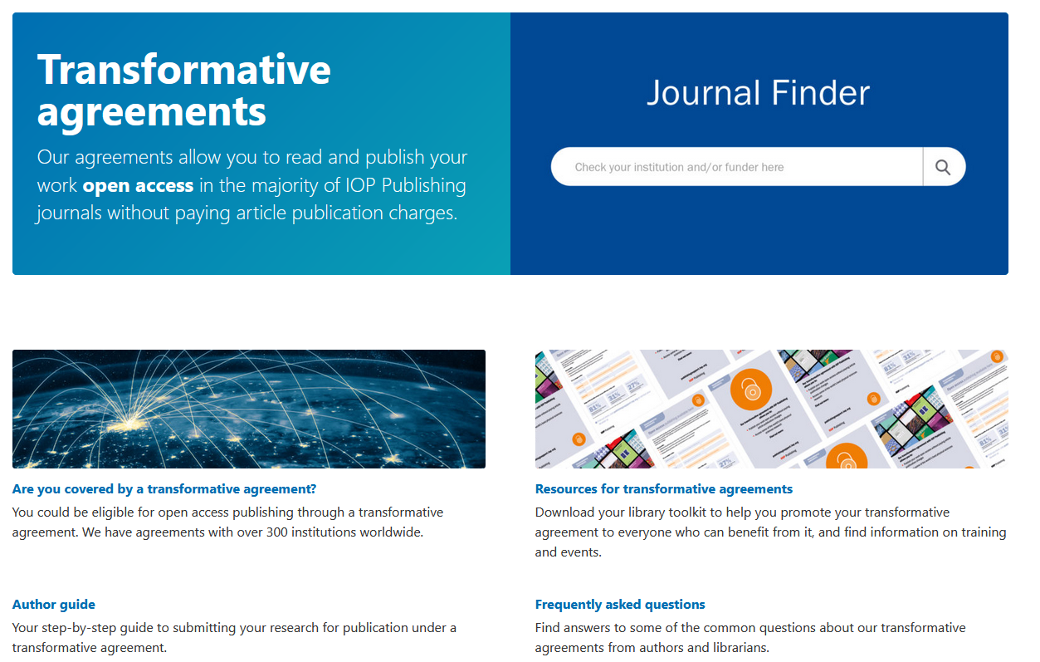
Iopscience.org/transformative-agreements

Slide 14
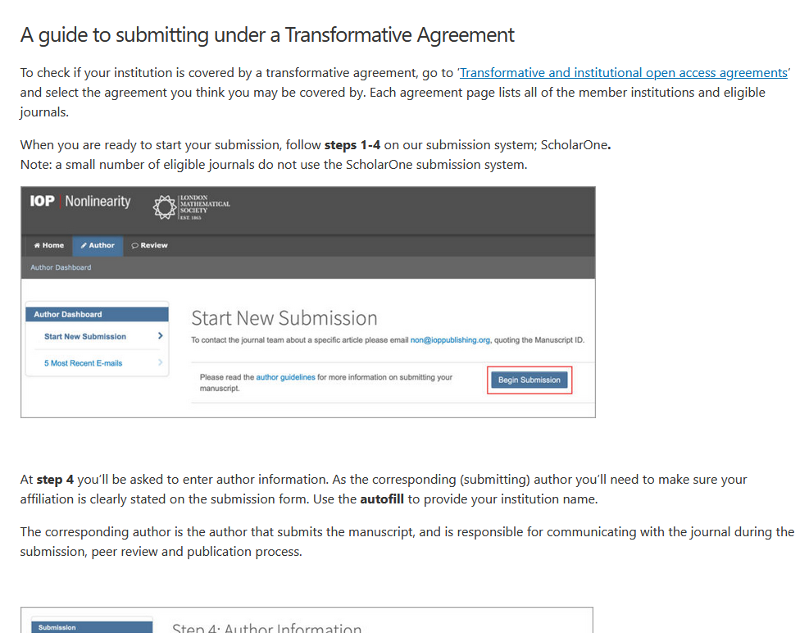
Support and training
Notes:
https://publishingsupport.iopscience.iop.org/questions/submit-under-a-transformative-agreement-guide/

Slide 15

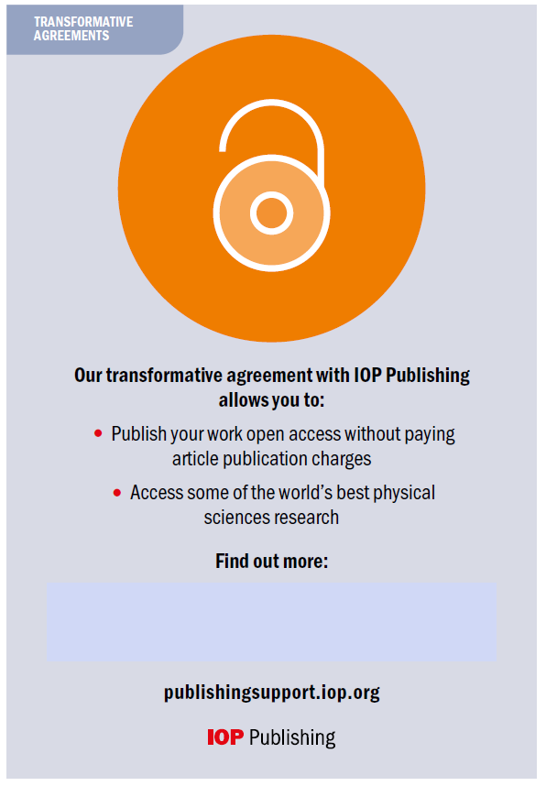
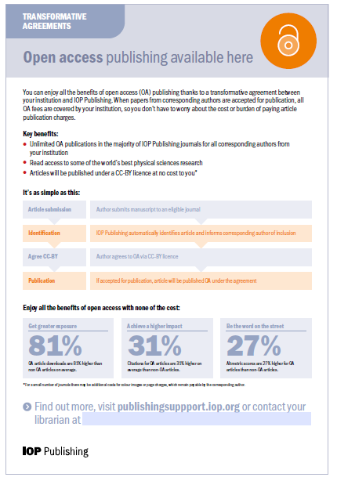

The library toolkit

